Slide 1





Every School Day is a New Day
Student Attendance Campaign 2025 Partner Pack

Slide 2
Overview
On September 24th, 2025, TESS and the Department of Education and Youth launched a nationwide multimedia campaign to promote regular school attendance across Ireland.
Campaign Goals
Raise awareness that children in Ireland are missing too much school
Bring the conversation back to basics: school is the priority. When children can be in school, they should be in school
Provide support for families across Ireland that may struggle from time to time with getting their children and young people into school

Slide 3
Campaign Approach
GET Parents, guardians, caregivers, family members, and other adults in
children’s lives
WHO Facilitate absenteeism of children and young people for reasons that would once have been previously unthinkable (birthdays, holidays, family events, mild worry or overwhelm, etc.)
TO Understand the scale of the school attendance problem that is persisting in Ireland since the Pandemic and
TO Consider that a day or two or three home from school here and there adds up and can have a large negative impact on children’s ability to achieve their full potential from education
BY Reminding them that regular school attendance is essential for academic achievement, wellbeing, social development and long-term life outcomes

Slide 4
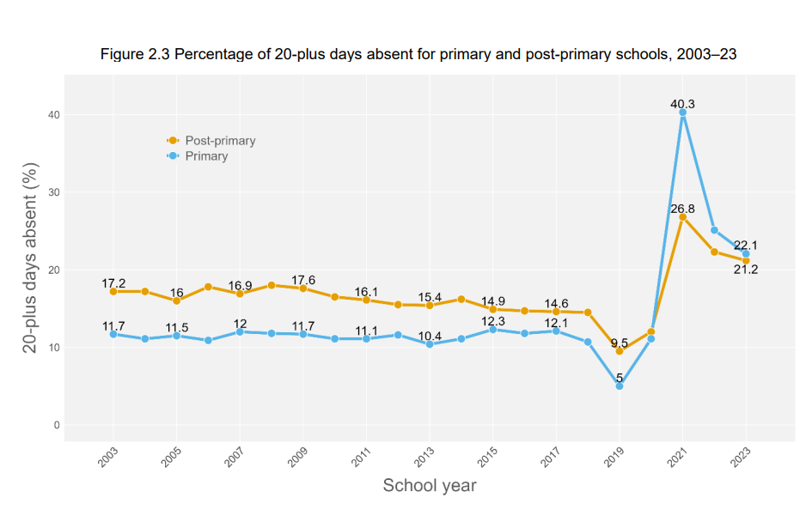
The Scale of the Problem
More than 1 in 5 students
are missing a month or more
of their school year.

Slide 5
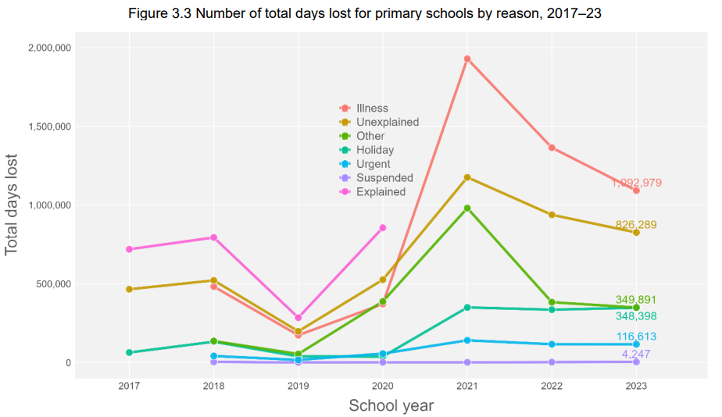
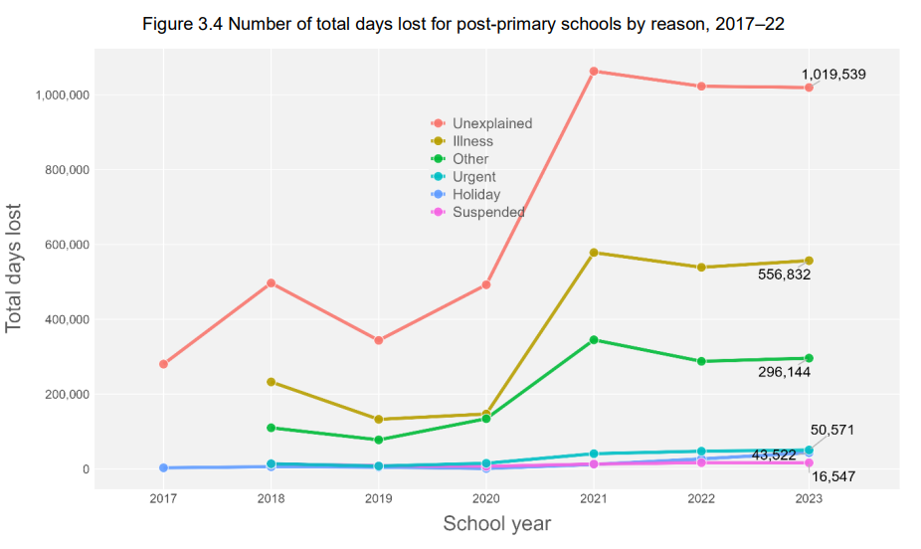

The total number of days lost by students at primary level represents
8% of all school days missed.
The total number of days lost by students at post-primary level represents
11.3% of all school days missed.

Slide 6
Channels and Dates
5 weeks, September 24th – October 30th, 2025
National and regional radio (incl. Irish): Sept 24—Oct 26
Digital display (websites, incl. Irish): Sept 24—Oct 26
Social media, paid and organic: Sept 24—Oct 26
Billboards, transport shelters, and airport: Sept 24—Oct 5
Cinema ad-reel: Sept 29—Oct 30
Video on demand (Streamable TV & YouTube): Sept 29—Oct 19
National TV (incl. Irish): Sept 29—Oct 12
National press ads: Sept 29—Oct 5
Applegreen digital displays: Oct 6 – Oct 20

Slide 7
Campaign Assets
Share the webpage with supports for parents and schools at gov.ie/SchoolAttendance
Link to our 30-second video ad (English) here
Link to our 30-second video ad (Irish) here
Download posters that can be printed or used online here
Read and share the TESS Analysis of School Attendance Data for 2023-24 here

Slide 8


Social Media Posts to Share (English)
Message
1 in 5 of our children are missing a month or more of their school year. When children miss school, they miss out. Find support at gov.ie/SchoolAttendance
*right click to save images

Slide 9




Social Media Posts to Share (English)
Message
1 in 5 of our children are missing a month or more of their school year. When children miss school, they miss out. Find support at gov.ie/SchoolAttendance
*right click to save images

Slide 10



Social Media Posts to Share (Irish)
Message
Tá páiste as gach cúigear ag cailleadh mí nó níos mó den scoilbhliain. Nuair a chailleann leanaí laethanta scoile, cailleann siad amach. Faigh tacaíocht ar gov.ie/FreastalScoile
*right click to save images

Slide 11




Social Media Posts to Share (Irish)
Message
Tá páiste as gach cúigear ag cailleadh mí nó níos mó den scoilbhliain. Nuair a chailleann leanaí laethanta scoile, cailleann siad amach. Faigh tacaíocht ar gov.ie/FreastalScoile
*right click to save images

Slide 12
Thank you for sharing this campaign among your networks
Contacts:
Joyce Armstrong Matthews, Tusla Communications
joyce.Matthews@tusla.ie
Louise Costello, Tusla Communications
louise.Costello@tusla.ie

