Slide 1
Study Seminar
Nine steps to effective study
Tips helping you study from The Meitheal Team

Slide 2
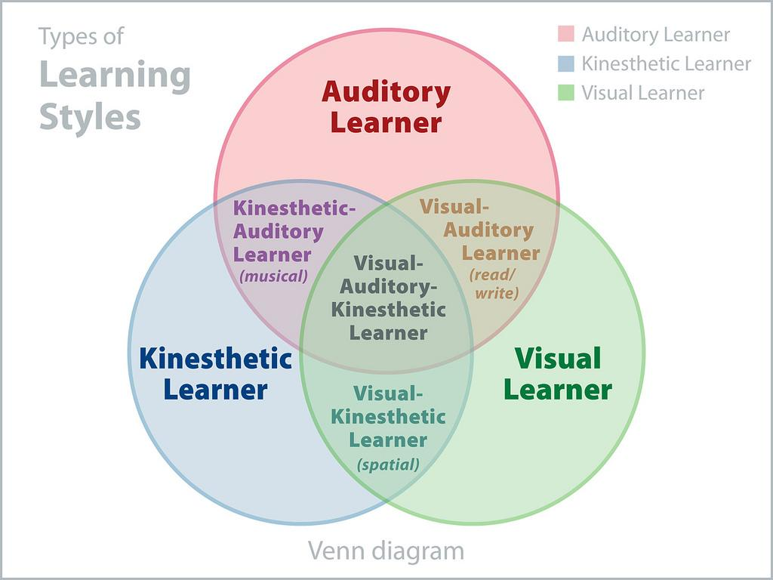
The Different Styles Of Learning…
Visual
Auditory
Kinestic

Slide 3


It’s important to try different
methods of learning to discover
what suits you best.
different studying skills may work for
certain subjects and not others!

Slide 4
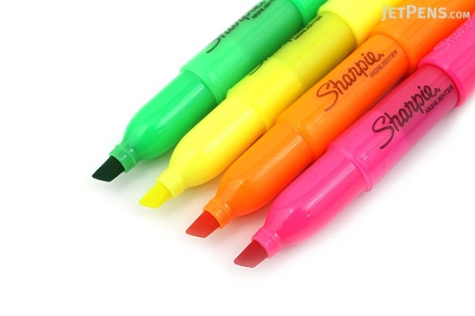

Visual Learners respond best to colour!
Try using highlighters to colour code
Taking neat easy to read notes will satisfy the brain making triggering your memory!
Visual Learning
Visual learners also respond to pictures!
Ever hear the phrase: “a picture is worth a thousand words?” Try using doodles/diagrams to remember key facts
Try Creating A Mind Map like this!
Mind maps are a great way to gather all your information from one chapter on a single page.
Priorities notes and summarise!
They are satisfying and more attractive to your brain

Slide 5

Auditory learning is learning through sound. LISTENING is
The more productive you
Are in class the less study at home!
Auditory Learning
A good method of learning is to try and explain a chapter to a friend! You are learning through speech and they get a free grind!
REPETITION!!!!!
A very common way of learning is repetition.
Revising and going over
your work again and again to put it into long term memory.
Music!
Creating rhymes and songs to remember lists of things is a very efficient way of memorising! They dont have to be symphonies… simple tunes work!( For some reason we can reenact every song from Frozen but can’t list the 7 Characteristics Of Living Things for science!!!

Slide 6
Try to prepare activities to your study regime. Challenge yourself to a list of questions and watch your improvement.
A tip for Kinesthetic Learners is to keep yourself active while studying! Don’t just sit there!
Try typing or writing out your notes keeping your hands active.
Kinesthetic
Learning
Kinesthetic learners respond to charts and diagrams! Try to convert paragraphs to colourful pretty diagrams
Quizzes is also a form of kinesthetic learning!
The action of writing out questions and answering them satifies the brain!
There is a free app called STUDYBLUE
It allows you to organise and type out flashcards.. putting questions on one side and the answers on the other!

Slide 7

Organisation
Organisation is :

Slide 8
Time Management
Make a weekly or daily to-do list
Get up early to get stuff done
Reward yourself when tasks are complete
Schedule your “me” time
(so it doesn’t eat up study time)

Slide 9
Managing Time When Studying
Read the syllabus and content of the textbook and make plans from it
Prioritize and schedule what you need to do – be realistic!
Set aside study/class work hours each day
Have a spot where all studying takes place

Slide 10
Note T aking!!

Slide 11
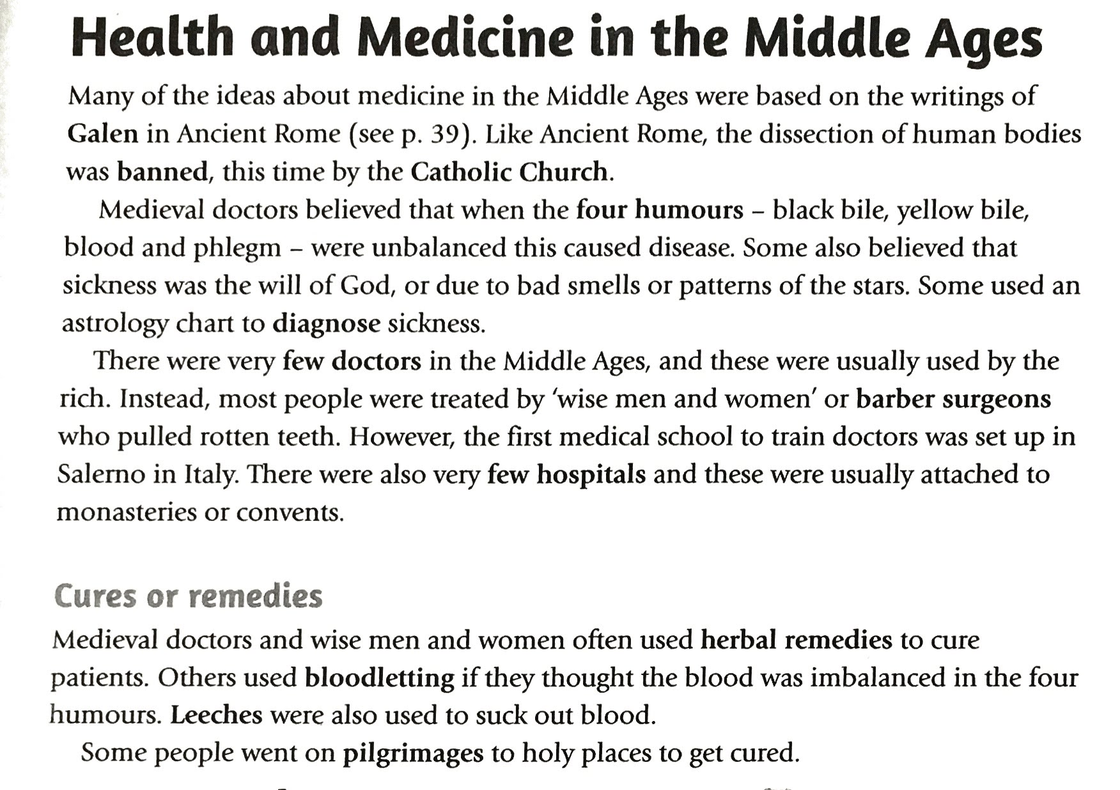

Slide 12
Note-Taking
Read text First
Gain an understanding
Read
Paraphrase
abbreviations
Paraphrase the text
Take up as much space as needed
Write as little as possible
abbreviate
Create your own abbreviations/
acronym

Slide 13
Test Preparation
Be caught up on all work for the test
Identify your problem areas
Make flashcards
Rewrite/re-read your notes; reorganize into categories
Don’t cram!
Know the test format
Verbalize what you know – tell/teach the material to someone else

Slide 14
Nine steps to effective study
Have a goal for each study session
Learn work to teach not to test
Just practise practise - helps see where help is needed
CANT FOCUS - exercise e.g. out on the trampoline / walk
No phone or music

Slide 15
Extra Tips!
Highlight and take notes
Make margin notes
Keep from dozing off: don’t study right before going to bed, and don’t read school books in bed
Pace yourself
Pay attention to key concepts and end of chapter reviews
Test what you already know in a chapter from the syllabus

Slide 16
Nine steps to effective study
Small short study sessions e.g. – 20mins with 5min break in 1styr 45mins in 3ndyr
use the Learning method
Take a break away for your study area
Create a schedule e.g. 3-4pm flexible and reviewed
Don’t rely on highlighting notes – make flash cards

Slide 17
Thank You

